Slide 1
Overview of ADAM – Analysis Data Model
Anagha Bhatkhande Varsha Mahajan
V 1.0
Effective date: 01-Nov-2017
Copyright © 2016 Tata Consultancy Services Limited
Notes:
Title Slide
Theme Image area
We need to place appropriate image based on the content of the Presentation
Version No
Release date
PALS logo
TCS logo
Theme 1-a
Align text to the bottom of the logo bottom line
Font size 10pt

Slide 2


Confidentiality Statement
This document contains information which is commercially confidential to Tata Consultancy Services Ltd. ("TCS") and is provided for the sole purpose of permitting the recipient to evaluate the proposal submitted within the document. In consideration of the receipt of this document, the recipient agrees to maintain the information it contains in confidence and not to reproduce or otherwise disclose the contents of this document to any person outside the recipient's evaluation team or nominated advisors. The document may not be used, reproduced or disclosed to others, except as specifically permitted by TCS in writing. The recipient of this document, by its retention and use, agrees to take reasonable endeavours to protect the document and the information it contains from loss or theft.
© 2017 - TATA Consultancy Services Limited (TCS)
TCS confidential

Slide 3
Agenda
Need of ADaM
ADaM structures
Concept of Traceability
Standard ADaM variable and naming conventions
ADaM variable rules
Navigating through ADaM IG

Slide 4
Why do we need ADaM?
Planning
Data Collection
Data Tabulations
Data Analysis
Analysis dataset
Traceability
Protocol
CDASH
SDTM
ADaM
Study Design
LAB
SEND
Tables
Listings
Figures
What is Analysis dataset?
What is ADaM dataset?
Does ADaM have any basic structure?
What are Non-ADaM analysis dataset?
How to differentiate ADaM and Non-ADaM datasets via the naming conventions?
TCS confidential
Notes:
Analysis dataset – An analysis dataset is defined as a dataset used for analysis and reporting.
ADaM dataset – An ADaM dataset is a particular type of analysis dataset that either:
(1) is compliant with one of the ADaM defined structures and follows the ADaM fundamental principles; or
(2) follows the ADaM fundamental principles defined in the ADaM model document and adheres as closely as possible to the ADaMIG variable naming and other conventions.
ADaM has three structures: ADSL (Subject-Level Analysis Dataset), BDS (Basic Data Structure), and OCCDS (Occurrence Data Structure). These three structures correspond to the SUBJECT LEVEL ANALYSIS DATASET, BASIC DATA STRUCTURE, and OCCURRENCE DATA STRUCTURE classes of ADaM datasets
Non-ADaM analysis dataset – A non-ADaM analysis dataset is an analysis dataset that is not an ADaM dataset.
Examples of non-ADaM analysis datasets include:
• an analysis dataset created according to a legacy company standard
• an analysis dataset that does not follow the ADaM fundamental principles.
ADaM datasets are prefixed with ‘AD’
Non-ADaM datasets are prefixed with “AX’

Slide 5
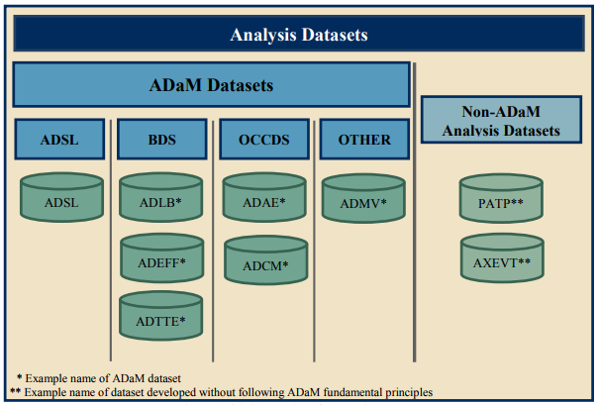
Analysis Datasets
Picture courtesy ADaM Implementation guideline CDISC.org
TCS confidential
Notes:
Analysis dataset – An analysis dataset is defined as a dataset used for analysis and reporting.
ADaM dataset – An ADaM dataset is a particular type of analysis dataset that either:
(1) is compliant with one of the ADaM defined structures and follows the ADaM fundamental principles; or
(2) follows the ADaM fundamental principles defined in the ADaM model document and adheres as closely as possible to the ADaMIG variable naming and other conventions.
ADaM has three structures: ADSL (Subject-Level Analysis Dataset), BDS (Basic Data Structure), and OCCDS (Occurrence Data Structure). These three structures correspond to the SUBJECT LEVEL ANALYSIS DATASET, BASIC DATA STRUCTURE, and OCCURRENCE DATA STRUCTURE classes of ADaM datasets
Non-ADaM analysis dataset – A non-ADaM analysis dataset is an analysis dataset that is not an ADaM dataset.
Examples of non-ADaM analysis datasets include:
• an analysis dataset created according to a legacy company standard
• an analysis dataset that does not follow the ADaM fundamental principles.
ADaM datasets are prefixed with ‘AD’
Non-ADaM datasets are prefixed with “AX’

Slide 6
ADaM Data Structures
Clear and Unambiguous connect between the Analysis datasets and associated Metadata supporting the statistical analyses performed in a clinical study – communicate the content and source of the datasets
Provide Traceability – data’s lineage or relationship between analysis value and its predecessor (derived, imputed)
Readily usable with commonly available software tools
Ease to perform statistical analysis with minimal programming – one proc away
Ease data review and re-creation of specific statistical Analysis
TCS confidential

Slide 7
Traceability
Assumption: Source for ADaM datasets are SDTM
Reality : Source for ADaM can be another ADaM
A CDISC compliant submission includes both SDTM and ADaM datasets ; relationship between SDTM and ADaM must be clear.
ADaM tries to balance ‘Traceability’ and ‘Analysis-Ready’ with a predictable structure
Contains derived data along with directly imported SDTM datasets
In case of records/observation not used for analysis are dropped then appropriate analysis flags are added to ease analysis
Traceability is key for reviewers since it helps identify
Information that exists in the submitted SDTM data
Information that is derived or imputed within the ADaM dataset
The method used to create derived or imputed data
Information used for analyses versus not used for analyses but is included in the dataset to support traceability or future analysis
Requires Traceability
Why Traceability?
TCS confidential
Notes:
In the ADaM model, it is assumed that the original data sources for ADaM datasets are SDTM datasets, even when ADaM datasets are derived from other ADaM datasets. ADaM has features that enable traceability from analysis results to ADaM datasets and from ADaM datasets to SDTM datasets.

Slide 8
Traceability
Two levels of Traceability:
Metadata traceability:
Required for ADaM compliance
Establishes the relationship of the analysis variable to its source dataset(s) and variables by describing the algorithm used to derive or populate it
Establishes the relationship between an analysis result & analysis dataset(s)
TCS confidential

Slide 9
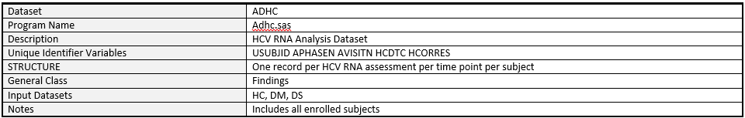
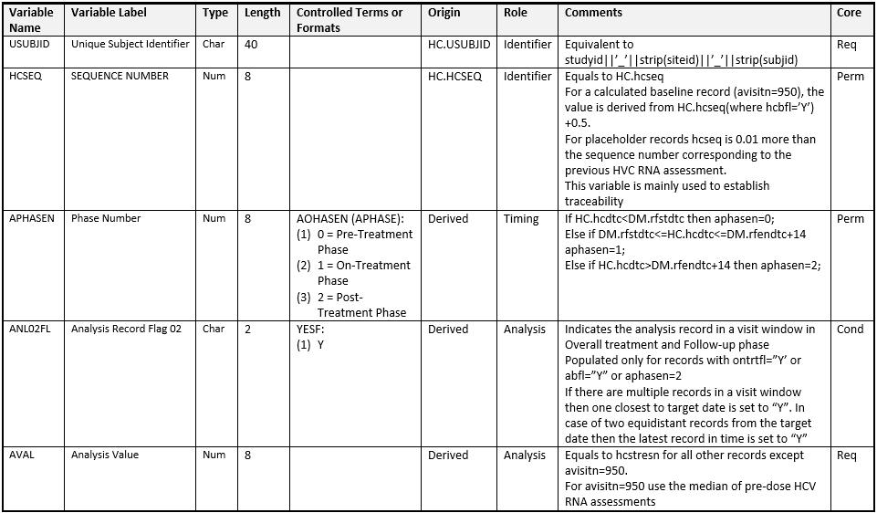
Metadata traceability
TCS confidential

Slide 10
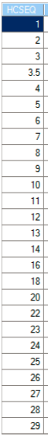
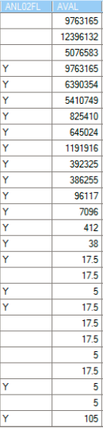
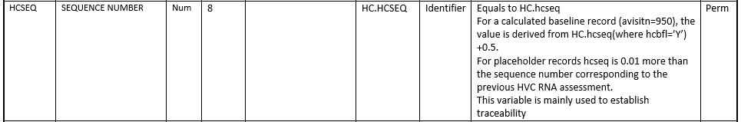
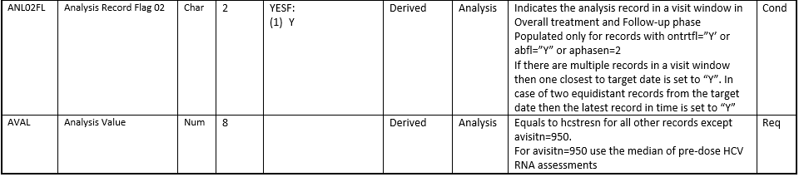
Metadata traceability
Origin
Derivation
Role
Type
TCS confidential

Slide 11
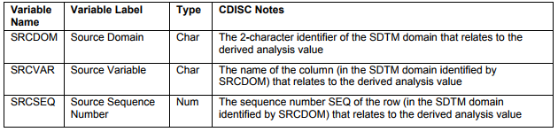
Traceability
Data point traceability:
Implemented if practical and feasible
Points directly to the specific predecessor record from SDTM to ADaM i.e. SDTM variables that are copied in to ADaM and should not be modified
Helps to trace the path of a complex data manipulation
Primary candidates for data point traceability:
SDTM Domain variable value
SDTM Source variable name
Relevant SDTM domain –SEQ value
These 3 with the analysis variable help link back to the source SDTM records
TCS confidential

Slide 12
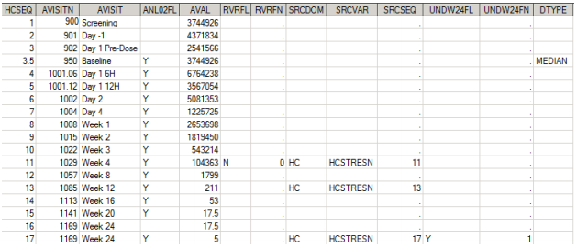
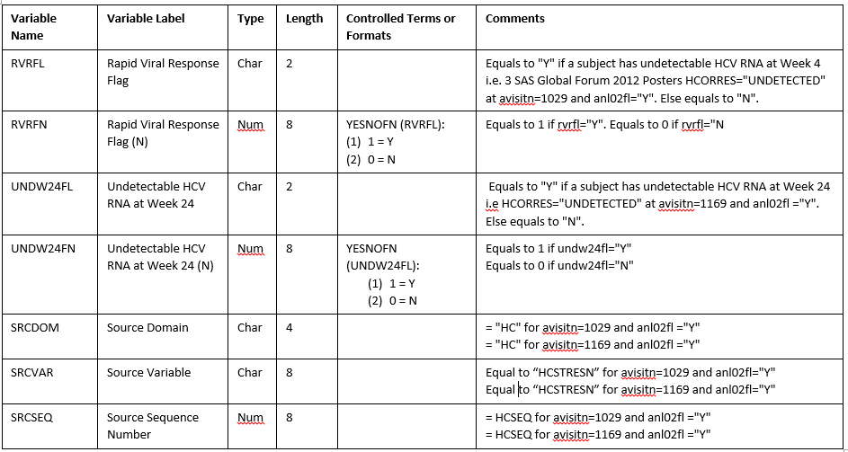
Data Point Traceability
Metadata
Derivation type
Data point
TCS confidential

Slide 13
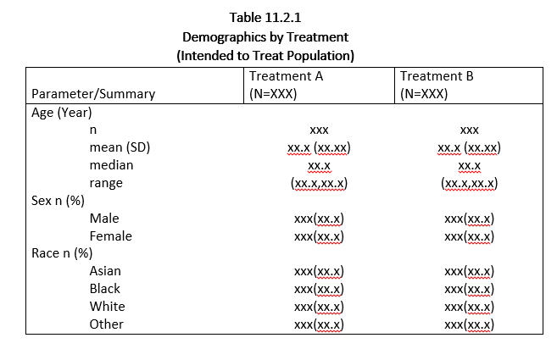
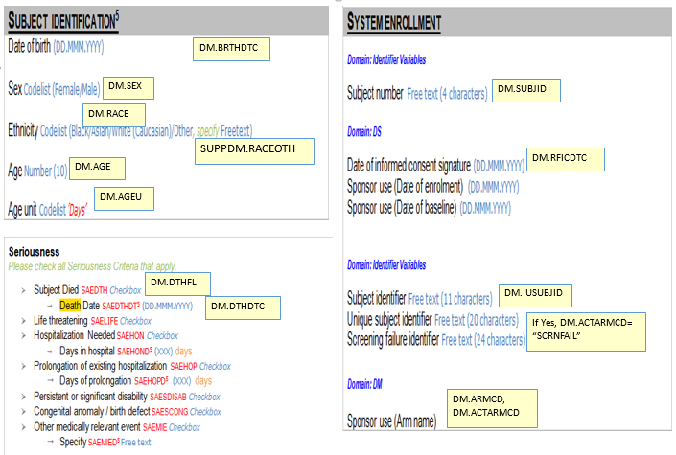
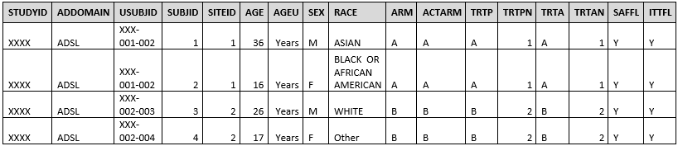
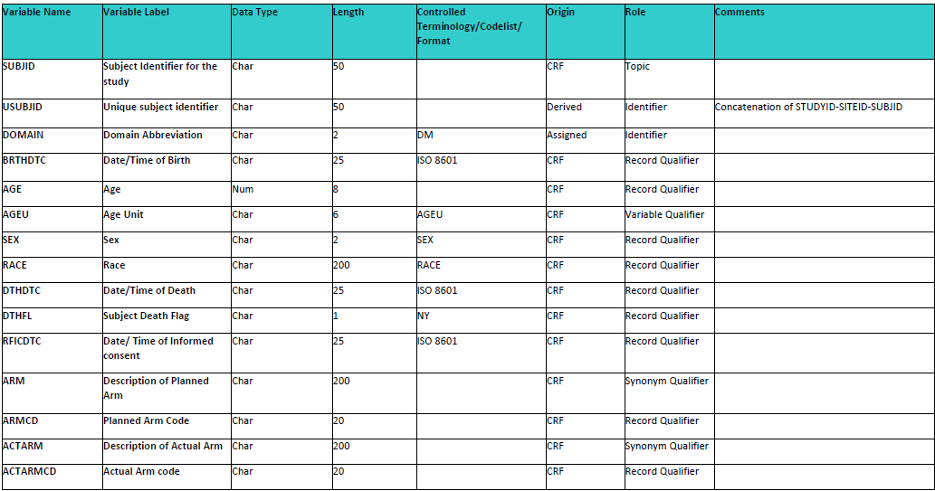
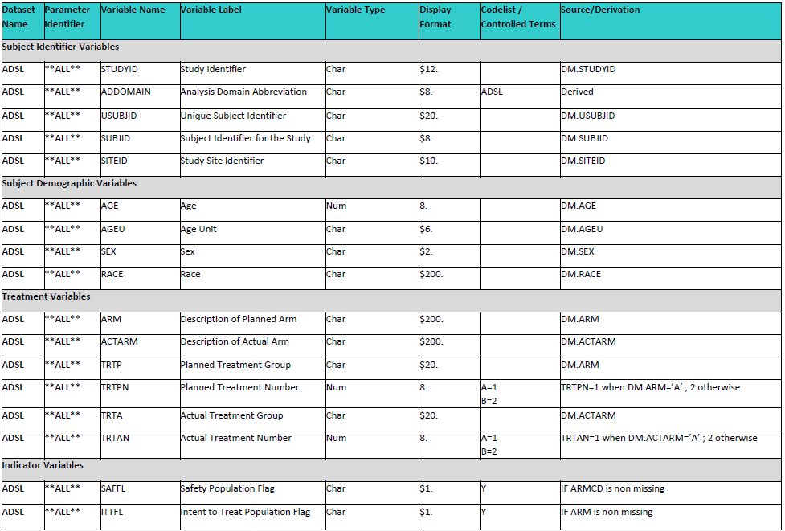
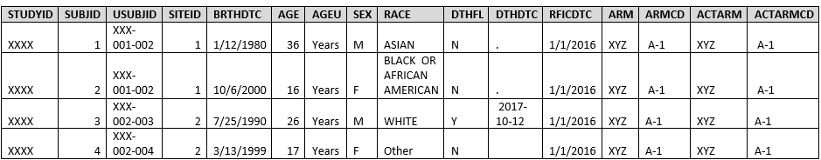
Traceability Cycle
Annotated CRF
Demographic Table
ADSL dataset
DM Metadata
DM dataset
ADSL Metadata
TCS confidential

Slide 14
ADaM Data Structures
Subject Level analysis Structure: The subject level analysis dataset: One record per subject e.g.: ADSL
Occurrence Data Structure (ODS): Contains all the event domains of SDTM. e.g.: ADAE
Basic Data Structure(BDS): Contains one or more records per subject, per analysis parameter, per analysis time point. Mostly contain the finding domains of SDTM e.g.: ADLB
Others
TCS confidential

Slide 15
General ADaM Definitions
Analysis-enabling – Required for analysis. A column or row is analysis-enabling if it is required to perform the analysis.
Traceability – The property that enables the understanding of the data’s lineage and/or the relationship between an element and its predecessor(s).
Supportive – A column or row is supportive if it is not required in order to perform an analysis but is included in order to facilitate traceability or review.
Record – A row in a dataset. A record is also referred to as an observation within this document.
Variable – A column in a dataset.
TCS confidential
Notes:
Examples: a hypertension category column added to the ADaM dataset to enable subgroup analysis; an age covariate added to enable the analysis to be age-adjusted; a center stratification factor in a multicenter study.
Traceability facilitates transparency, which is an essential component in building confidence in a result or conclusion. Ultimately, traceability in ADaM permits the understanding of the relationship between the analysis results, the ADaM datasets, the SDTM datasets, and the data collection instrument. Traceability is built by clearly establishing the path between an element and its immediate predecessor. The full path is traced by going from one element to its predecessors, then on to their predecessors, and so on, back to the SDTM datasets, and ultimately to the data collection instrument.
Example: the LBSEQ and VISIT columns were carried over from SDTM in order to promote understanding of how the ADaM dataset rows relate to the study tabulation dataset.

Slide 16
Standard ADaM Variables
ADaM variables are classified as:
Required (Req) : This variable must be included in the dataset
e.g. : STUDYID, USUBJID, SUBJID, SITEID, etc.
Conditional (Cond) : This variable must be included in the dataset in certain circumstances
e.g. : FASFL, SAFFL, ITTFL, etc.
Permissible (Perm) : This variable may be included in the dataset, but is not required
e.g. : SITEGRy, TRTxxPN, etc.
All ADaM variables are populated as per their classification ; nulls are allowed
TCS confidential

Slide 17
ADaM variable Conventions
The variable conventions are defined to ensure compliance with SAS version 5 transport file format and Oracle constraints
Variable names should be less than or equal to 8 characters in length
Variable names to start with a letter and not underscore
Variable names can be comprised only of letters (A-Z), underscore(_) and numerals (0-9)
Variable labels should be less than or equal to 40 characters in length
All ADaM character variable length should not be more than 200 characters in length
In SDTM if a character variable has length more than 200 characters then the remaining portion is added in SUPP domain but in ADaM it is in the same domain.
General Variable Conventions
TCS confidential

Slide 18
ADaM variable Conventions
General Variable Conventions
Any SDTM variable directly copied in to ADaM dataset should maintain its attributes as in the SDTM (same name, same meaning, same values)
Any ADaM standard variable defined must be used, even if the content is a direct copy of the SDTM variable e.g. AVAL variable in ADLB is just a copy of LBSTRESN the dataset must contain AVAL
In case of paired variables, the secondary variable is presented in the dataset only in the presence of primary variable. Relevant suffix is used only for the secondary variable (e.g. C-character, N-numeric) e.g. TRTP and TRTPN
TCS confidential
Notes:
The primary variable TRTP is already character so it is not named as TRTPC.

Slide 19
ADaM variable Conventions
Character variables converted to Numeric have to be suffixed with ‘N’. In case the variable name is already 8 characters then the last character is replaced by ‘N’
The character date variables converted to Numeric have the following naming convention *DT, *TM and *DTM
Character flag variables end in ‘FL’; numeric in ‘FN’
Variables whose names end in GRy, Gy, or CATy are grouping variables, where y refers to the grouping scheme or algorithm (not the category within the grouping); Numeric version of the variable will use the suffix GRyN (or GyN)
Grouping variable created from a predecessor variable should begin with the name of the variable being grouped e.g. AGEN, AGECAT
General Variable Conventions
TCS confidential
Notes:
Gry is the suffix used for grouping variables, where y refers to the grouping scheme or algorithm. GRy can be abbreviated to Gy to comply with the variable name length limit of 8 characters. Numeric version of the variable will use the suffix GRyN (or GyN).

Slide 20
ADaM variable Conventions
xx Parameter : The xx parameter represents a two-digit period. Valid values are 01–99 e.g. : TRTxxP etc.
y Parameter : The y parameter represents a single-digit grouping or category, an analysis criterion, or an analysis range. Valid values are 1–9 e.g. :SITEGRy etc.
zz Parameter : The zz parameter represents a two-digit index for the zzth record selection algorithm e.g. : ANLzzFL etc.
Variables with xx, y and zz parameters
TCS confidential

Slide 21
Timing variable Conventions
Variables with names ending in
DT are numeric dates
DTM are numeric datetimes
TM are numeric times
DY are relative day variables
Names of timing start variables end with
A ‘S’ followed by the two characters indicating the type of timing (e.g., SDT, STM)
Names of timing end variables end with
An ‘E’ followed by the two characters indicating the type of timing (e.g., EDT, ETM)
TCS confidential
Notes:
The reader is cautioned that the root or prefix (represented by *) of such producer-specified supportive ADaM date, time and datetime variable names must be chosen with care, to prevent unintended conflicts among other such names and standard numeric versions of possible SDTM variable names. In particular, potentially problematic values for producer-defined roots/prefixes (*) include: a. One-letter prefixes. For an example of the problem, if * is Q, then a date *DT would be QDT; however, a starting date *SDT would be QSDT, which would potentially be confusing if the producer intended QSDT to be something other than the numeric date version of the SDTM variable QSDTC.
b. Two-letter prefixes, except when intentionally chosen to refer explicitly to a specific SDTM domain and its --DTC, --STDTC, and/or --ENDTC variables. For an example of an appropriate intentional use of a two-letter prefix, if * is LB, then *DT is LBDT, the numeric date version of SDTM LBDTC. For an example of the problem, if * is QQ, then a date *DT would be QQDT, which would potentially be confusing if the producer intended QQDT to be something other than the numeric date version of a potential SDTM variable QQDTC.
c. Three-letter prefixes ending in S or E. For an example of the problem, if * is QQS, then a date *DT would be QQSDT, which would potentially be confusing if the producer intended QQSDT to be something other than the numeric date version of a potential SDTM variable QQSTDTC.
12. In general, all three of *DT, *TM, *DTM are not required. Include only the *DT, *TM, and *DTM variables needed for analysis or review. However, when a *DTM variable exists, it is good practice to include a corresponding *DT variable.

Slide 22
Flag and Group variables
Subject level population flags in the analysis datasets end in FL and FN (Character and Numeric); values (Yes, No and 1, 0)
Parameter level population flags end in PFL and PFN ; values (Yes,1) null records not included
Record level population flags end in RFL and RFN; values (Yes,1) null records not included
Date time imputation flags end in F
*DTF represent Date imputation flags
*TMF represent Time imputation flags
Both *DTF and *TMF describe the level of imputation
*DTF can take values Blank, D, M, Y
*TMF can take values H, M, S
TCS confidential
Notes:
Primary flagging is subject level
Subgroup is parameter level → based on a group/ category
Sensitivity is record level→ perprotocol

Slide 23
Additional Fragments
Fragments | Definition
BL | Baseline, position relative to type of variable. E.g. SBP01BL, SBP02BL Systolic blood pressure for two periods
CHG | Change, position relative to type of variable. E.g. SBP01CHG Systolic blood pressure change from baseline for period 1
FU | Follow-up, position relative to type of variable. E.g. FUENDT Follow-up end date
OT | On treatment, position relative to type of variable. E.g. ONTRTFL On treatment Flag
RU | Run-in, position relative to type of variable. E.g. RUSDT Run-in start date
SC | Screening, position relative to type of variable. E.g. WEIGHTSC or WTSC
U | Units, suffix
WA | Washout, position relative to type of variable. E.g. WA01SDT, WA01EDT, WA02SDT and WA02EDT Wash out start and end dates for two periods
TCS confidential

Slide 24
ADaM Treatment Variables
Treatment variables are required in all analysis datasets
Actual Treatment variables are required when they do not match with the planned treatment
Variable Name | Label | Type | Source
TRTxxP | Planned Treatment for Period xx | Char | TRTxxP might be derived from the SDTM DM variable ARM. At least TRT01P is required
TRTxxPN | Planned Treatment for Period xx (N) | Num | The numeric code variable for TRTxxP. One-to-one mapping to TRTxxP within a study
TRTxxA | Actual Treatment for Period xx | Char | Subject-level identifier that represents the actual treatment for the subject for period xx. Required when actual treatment does not match planned.
TRTxxAN | Actual Treatment for Period xx (N) | Num | TRTxxAN Actual Treatment for Period xx (N). One-to-one mapping to TRTxxA within a study
TCS confidential

Slide 25
ADaM Common Variables
Identifiers
USUBJID, STUDYID
Demographic Variables e.g. AGE, RACE, SEX etc.
Population Flags e.g. ITTFL, SAFFL, FASFL etc.
Baseline Flag variable i.e. ABLFL
Treatment Variables e.g. TRTxxP, TRTxxA
TCS confidential

Slide 26
ADaM variable rules
Anagha Bhatkhande Varsha Mahajan
V 1.0
Effective date: 01-Nov-2017
Copyright © 2016 Tata Consultancy Services Limited
Notes:
Title Slide
Theme Image area
We need to place appropriate image based on the content of the Presentation
Version No
Release date
PALS logo
TCS logo
Theme 1-a
Align text to the bottom of the logo bottom line
Font size 10pt

Slide 27
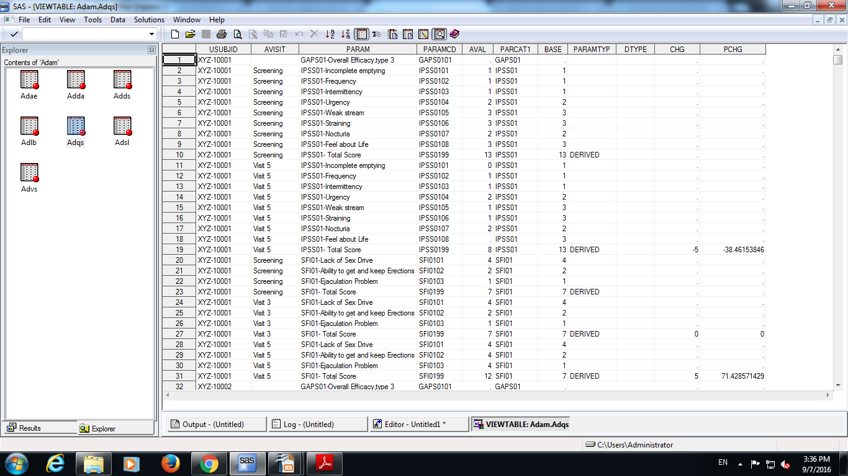
Rules for creation of rows and columns in ADaM
Rule 1 :
A parameter-invariant function of AVAL and BASE on the same row that does not involve a transform of BASE should be added as a new column.
Example of Rule 1: CHG or PCHG as both are derived from AVAL and BASE on the same row and are calculated for all the rows and there is no transformation of BASE.
TCS confidential

Slide 28
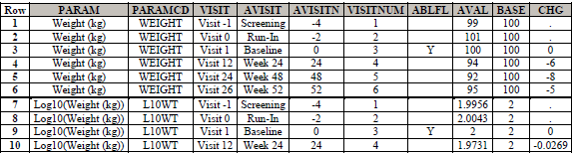
Rules for creation of rows and columns in ADaM
Rule 2 :
A transformation of AVAL that does not meet the conditions of Rule 1 should be added as a new parameter, and AVAL should contain the transformed value
TCS confidential
Notes:
Example of rule 2,3,4,5: The table in the next slide contain a variable PARAM which has the values “SFI01- Total Score” and “IPSS01- Total Score” are the function of more than one row or parameter.

Slide 29
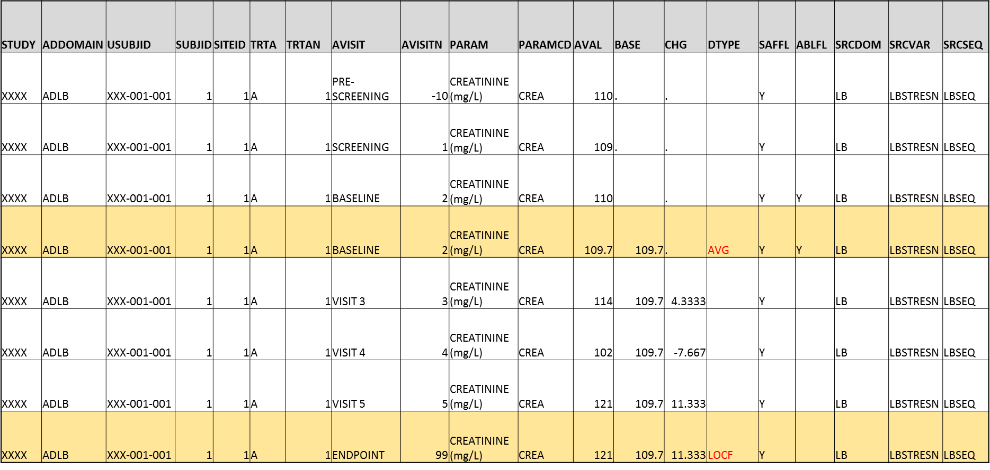
Rules for creation of rows and columns in ADaM
Rule 3 :
A function of one or more rows within the same parameter for the purpose of creating an analysis timepoint should be added as a new row for the same parameter.
TCS confidential
Notes:
Example of rule 2,3,4,5: The table in the next slide contain a variable PARAM which has the values “SFI01- Total Score” and “IPSS01- Total Score” are the function of more than one row or parameter.

Slide 30
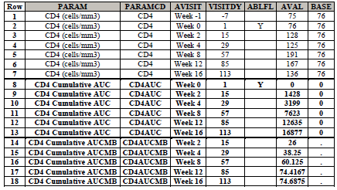
Rules for creation of rows and columns in ADaM
Rule 4 :
A function of multiple rows within a parameter should be added as a new parameter.
Rule 4 is a special case of Rule 2. The functions covered by this rule violate the second condition of Rule 1 (they are not same-row functions of AVAL), and may also violate the first and third conditions.
Let AVAL(t) equal the value of CD4 cell count at post-baseline visit t, and let VISITDY(t) be the planned study day of visit t.
CD4AUC (cumulative daily CD4 count over follow-up) is calculated at any given post-baseline visit as follows:
• CD4AUC at baseline visit is set to 0.
• CD4AUC(t) = CD4AUC(t-1) + [ 0.5 * AVAL(t-1) + 0.5 * AVAL(t) ] * [ VISITDY(t) - VISITDY(t-1) ].
CD4AUCMB (cumulative average change from baseline in daily CD4 count over follow-up) is calculated as
• CD4AUCMB(t) = CD4AUC(t) / [ VISITDY(t) - 1 ] - baseline value of CD4 cell count.
TCS confidential
Notes:
Example of rule 2,3,4,5: The table in the next slide contain a variable PARAM which has the values “SFI01- Total Score” and “IPSS01- Total Score” are the function of more than one row or parameter.

Slide 31
Rules for creation of rows and columns in ADaM
Rule 5 :
A function of more than one parameter should be added as a new parameter
BMI= Weight(kg)/[Height(m)]²
AVISIT | AVISITN | PARAM | PARAMCD | AVAL
BASELINE | 2 | Height (cm | HGT | 157
PRE-SCREENING | -10 | Weight (kg) | WGT | 60
SCREENING | 1 | Weight (kg) | WGT | 61
BASELINE | 2 | Weight (kg) | WGT | 61
VISIT 3 | 3 | Weight (kg) | WGT | 60.8
VISIT 4 | 4 | Weight (kg) | WGT | 60.5
VISIT 5 | 5 | Weight (kg) | WGT | 60
BASELINE | 2 | BMI (kg/m2) | BMI | 24.74745
VISIT 3 | 3 | BMI (kg/m2) | BMI | 24.66632
VISIT 4 | 4 | BMI (kg/m2) | BMI | 24.54461
VISIT 5 | 5 | BMI (kg/m2) | BMI | 24.34176
TCS confidential
Notes:
Example of rule 2,3,4,5: The table in the next slide contain a variable PARAM which has the values “SFI01- Total Score” and “IPSS01- Total Score” are the function of more than one row or parameter.

Slide 32
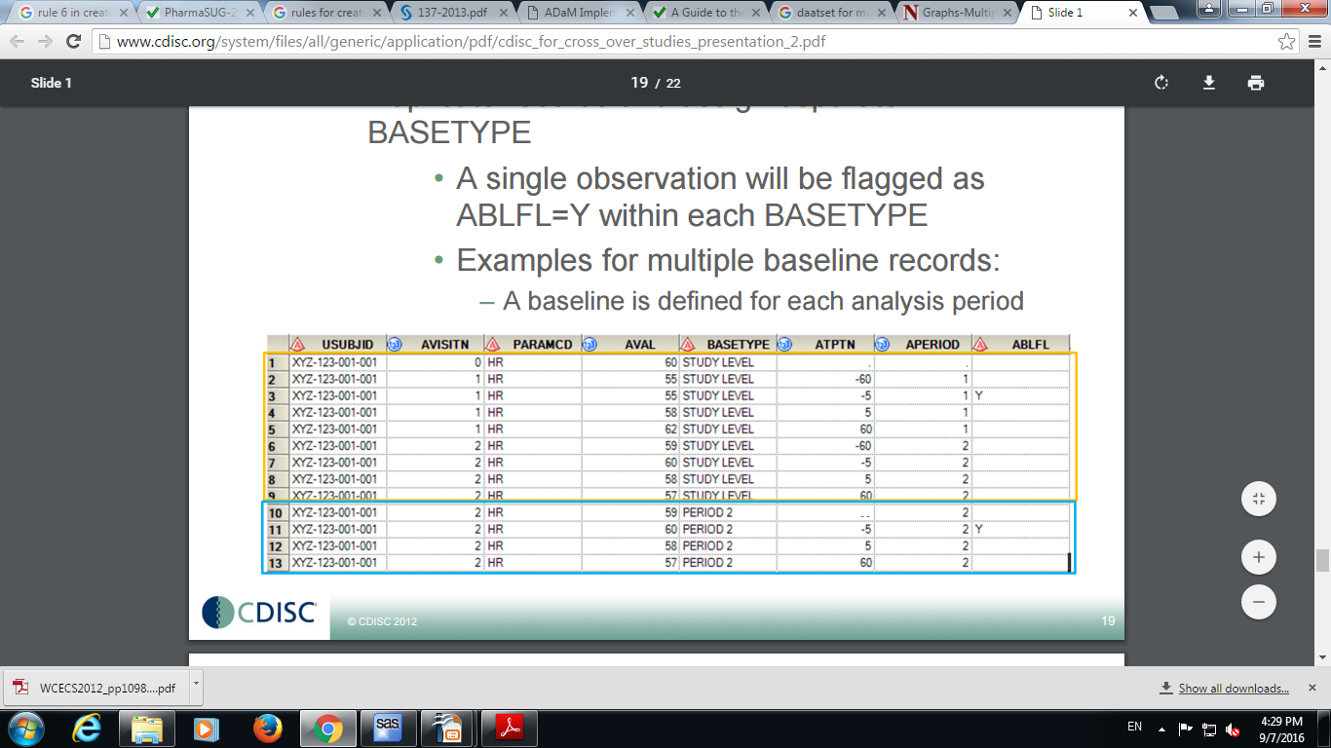
Rules for creation of rows and columns in ADaM
Rule 6 :
When there is more than one definition of baseline, each additional definition of baseline requires the creation of its own set of rows.
TCS confidential

Slide 33
Navigating through ADaM IG
Anagha Bhatkhande Varsha Mahajan
V 1.0
Effective date: 01-Nov-2017
Copyright © 2016 Tata Consultancy Services Limited
Notes:
Title Slide
Theme Image area
We need to place appropriate image based on the content of the Presentation
Version No
Release date
PALS logo
TCS logo
Theme 1-a
Align text to the bottom of the logo bottom line
Font size 10pt

Slide 34
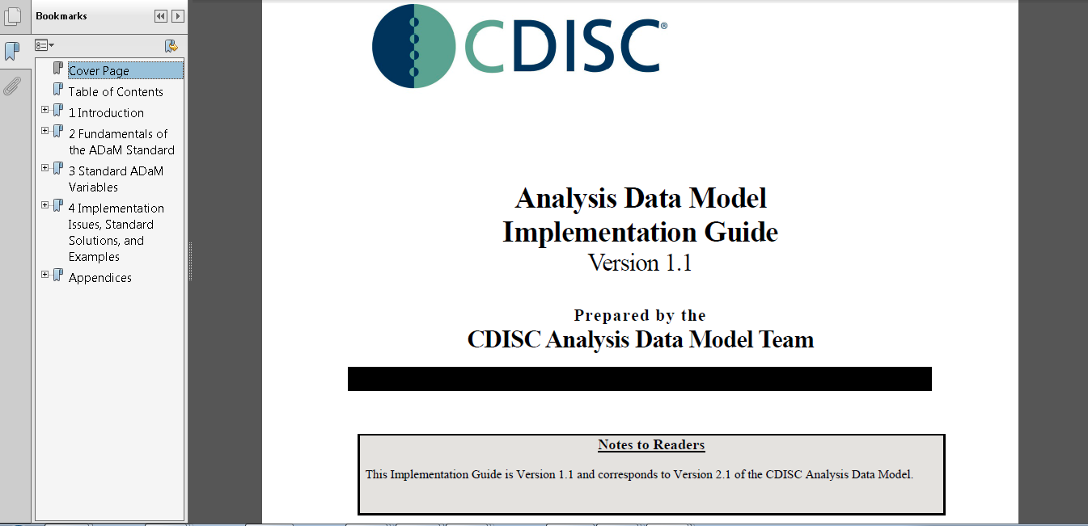
ADaM IG
TCS confidential

Slide 35
References
Reference
Reference
Reference
Reference
Reference
Reference
Notes:
Content Slide- 2 row / comparison

Slide 36
Thank You
For any feedback/comment/clarification please contact us at PALS@tcs.com
V NN

Slide 37
Document Release Notice
This XXXXXXX, Version NN, is released for use in Tata Consultancy Services (TCS) with effect from – DD-Mmm-YYYY.
This Training Material is subject to TCS Document Control Procedure. TCS reserves the right to make additions, modifications or alterations to the existing content or release a newer version of this document.
Softcopy of the latest version of the document is available in the ABCDEFG
Comments suggestions or queries should be addressed to PALS@tcs.com.
Date: DD-Mmm-YYYY
Date: DD-Mmm-YYYY
Document Name
Effective Date: DD-MMM-YYYY
V NN
Notes:
Font size 9pt

Slide 38
Change/Revision History
Version No. | Revision Description | Slide No. | Rationale for the Change | Change type (Add/Modify/Delete) | Modified By | Date Modified (DD-Mmm-YYYY)
V NN

